Slide 1
Operation Analytics and Investigating Metric Spike
Zaid Mohammad

Slide 2
Project Description
Operation Analytics helps a company understand how well its different departments, like operations, support, and marketing, are working. By analyzing data, the company can find areas to improve and make better decisions. This type of analysis is important because it helps predict whether a company will grow or face problems. It also makes teamwork smoother and workflows more efficient.
A key part of this is investigating metric spikes, which means figuring out why something suddenly changes, like a drop in the daily user activity or lower sales. As a Data Analyst, your job is to find answers to these questions using data. In this project, you are working as a Lead Data Analyst for a company like Microsoft, using different datasets to analyze trends and provide insights to various teams.

Slide 3
Tech Stack
MS - Excel
MySQL Workbench
SQL
PowerPoint

Slide 4

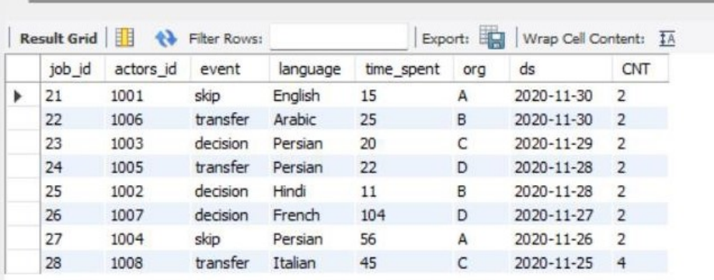
CASE STUDY 1 (Job Data)
The Job Data Dataset

Slide 5
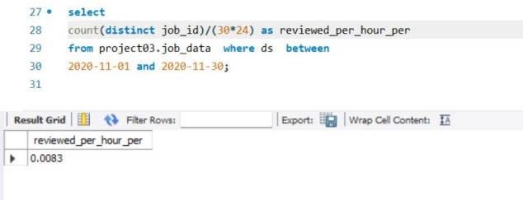
SQL QUERIES : A. Jobs Reviewed Over Time:

Slide 6
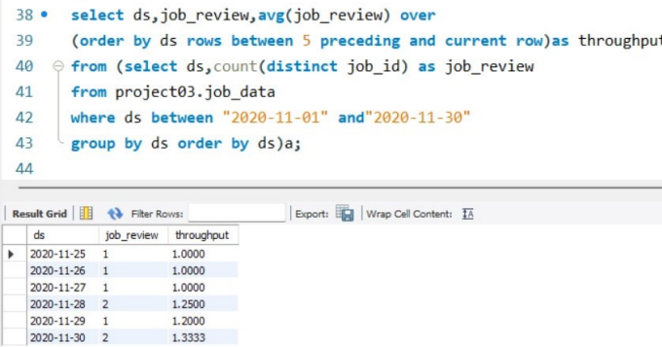
B. Throughput analysis:

Slide 7
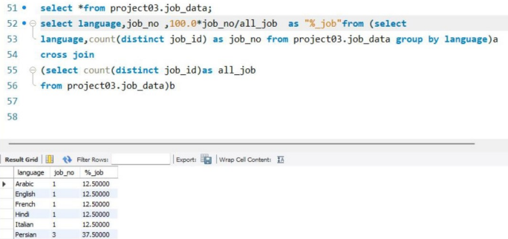
C. Language Share Analysis:

Slide 8
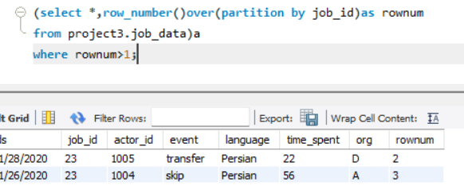
D. Duplicate Rows detection:

Slide 9
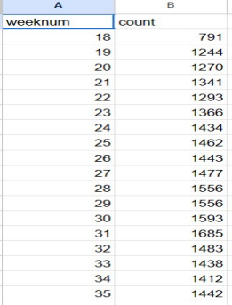

Case Study 2 (Investigating metric spike) A. Weekly User Engagement:
Output
Query

Slide 10
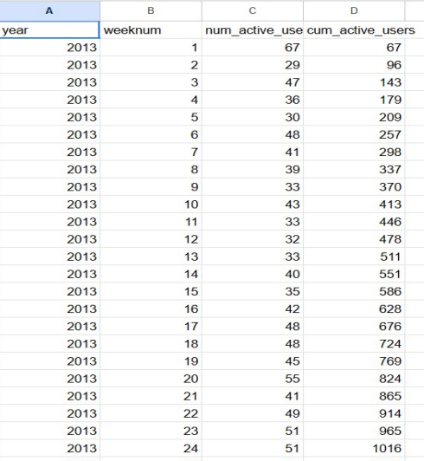

B. User growth Analysis:
Output
Query

Slide 11
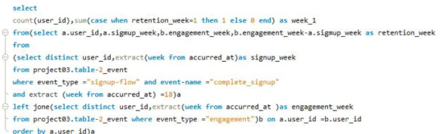

C. Weekly retention analysis:
Query
Output

Slide 12
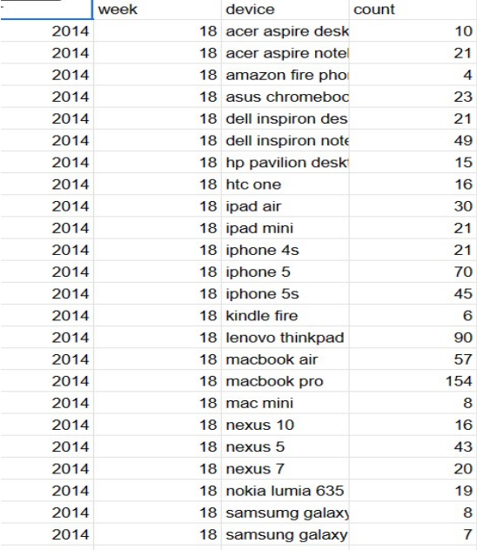

D. Weekly Engagement per device:
Output
Query

Slide 13
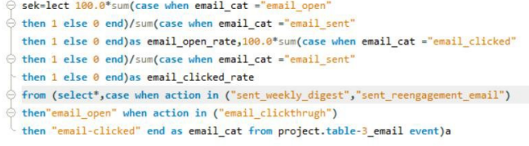

E. Email Engagement:
Query
Output

Slide 14
Insights
This project helped us understand how a company’s daily operations work and how we can use data to improve them. We analyzed job reviews, how quickly work is done, language preferences, and duplicate records. This showed us how companies track performance and make better decisions.
We also learned how to investigate sudden changes in user activity, like why people stop using a product or why sales drop. By looking at user growth, retention, and engagement, we helped answer important business questions.
In the end, this project showed us how data can help companies find problems, improve teamwork, and make smarter decisions.

